Slide 1

AJAY BINAY INSTITUTE OF TECHNOLOGY
Name : Abhishek Nayak
Regd No. : 1901206041
Branch : CSE

Slide 2
Git and Github

Slide 3
Content
Steps to Create a Repo and Upload Your Files
Disadvantages
Conclusion
End
2
4
6
8
Introduction
1
3
5
7
Advantages
Future Scope
References

Slide 4
Introduction
Git is a distributed version control system: tracking changes in any set of files, usually used for coordinating work among programmers collaboratively developing source code during software development. Its goals include speed, data integrity, and support for distributed, non-linear workflows.
GitHub is a code hosting service for software development and version control using Git. It provides the distributed version control of Git plus access control, bug tracking, software feature requests, task management, continuous integration for every project.

Slide 5
Steps to Create a Repo and upload Files
CREATE A REPO IN GITHUB
Create a repository in GitHub and copy the remote from the given data.
INITIALISATION
Then we need to initialise the location where we are having all our files by using command (Git init).
ADDING THE FILE
Then we need to add the files by using command (Git add .) that means all the files inside that location will be added.
COMMITING THE UPDATES
If a particular task is done then we need to commit that by leaving some message by using command (Git commit –m “initial commit”).
ADD REMOTE
Then we need to add that remote URL which we have copied from GitHub to create a pipeline connection between Git and GitHub.
PUSH
When all the above steps are done we can push it by using command (Git Push origin master). Then we can see our files there in Github.

Slide 6
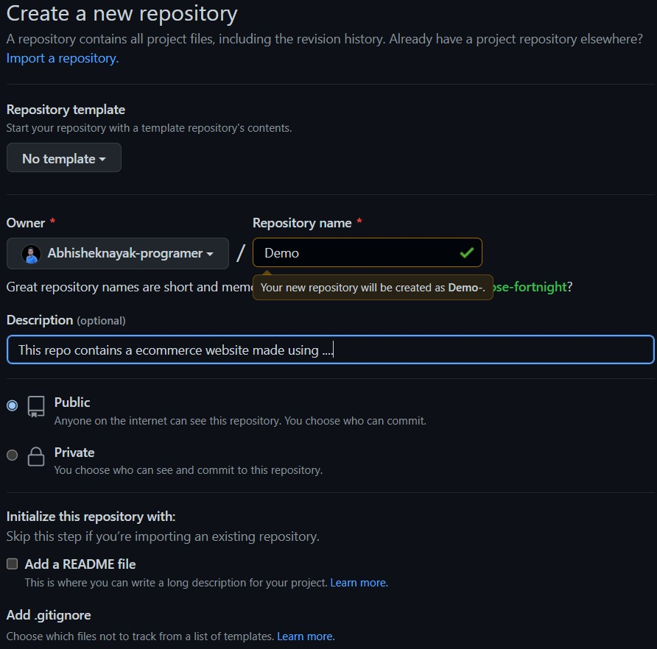
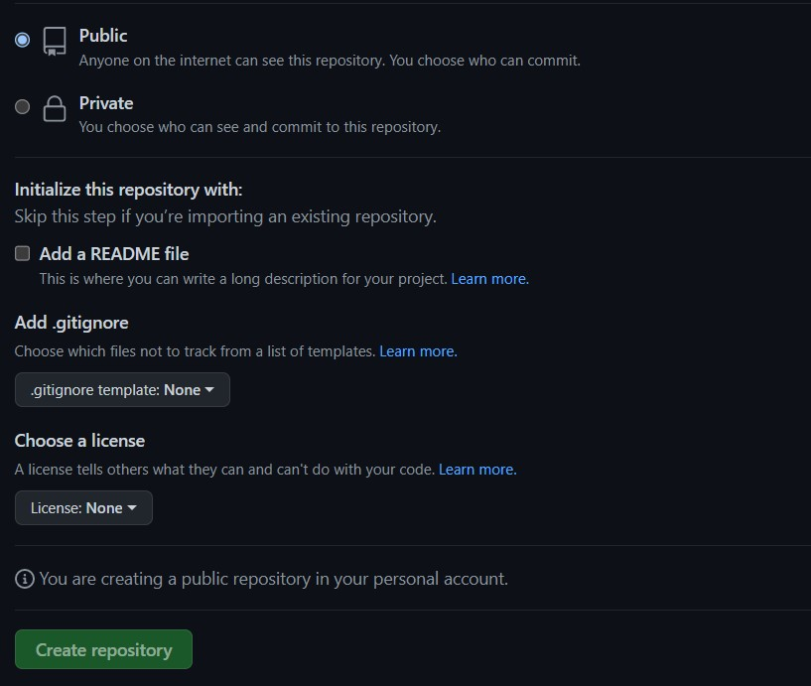
Git and GitHub Integration

Slide 7
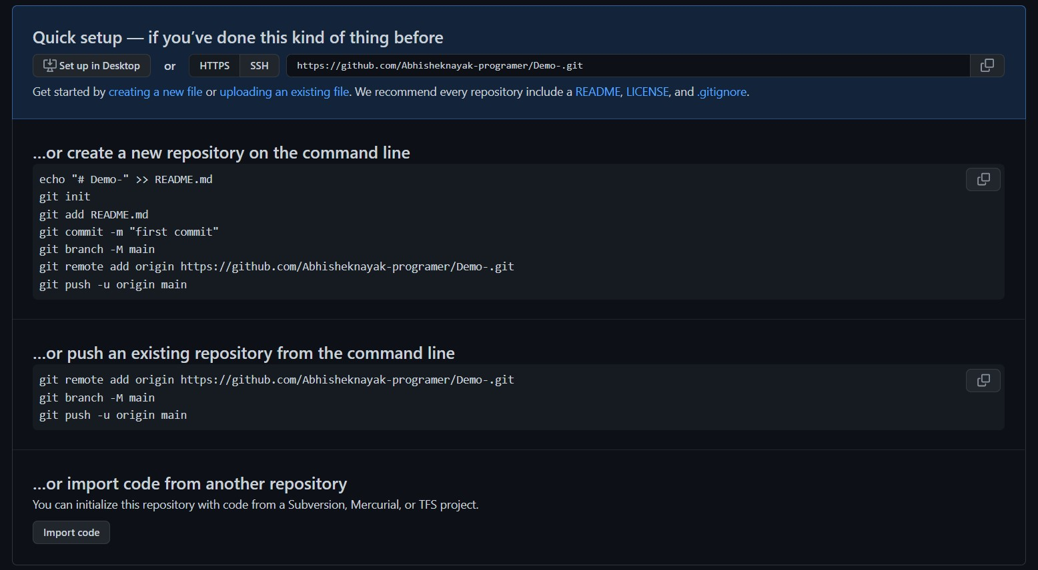

Slide 8
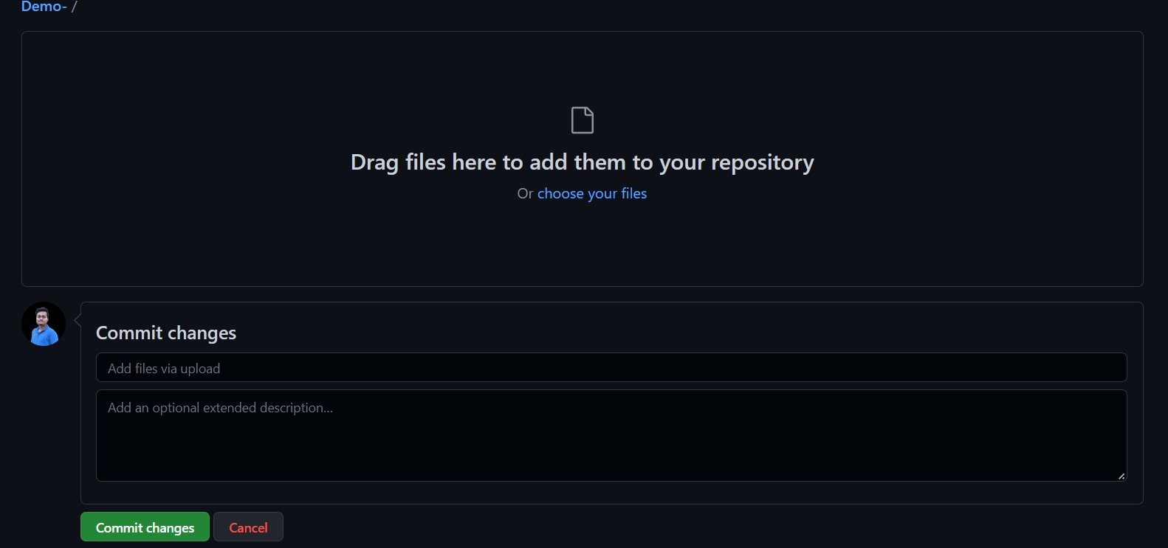

Slide 9
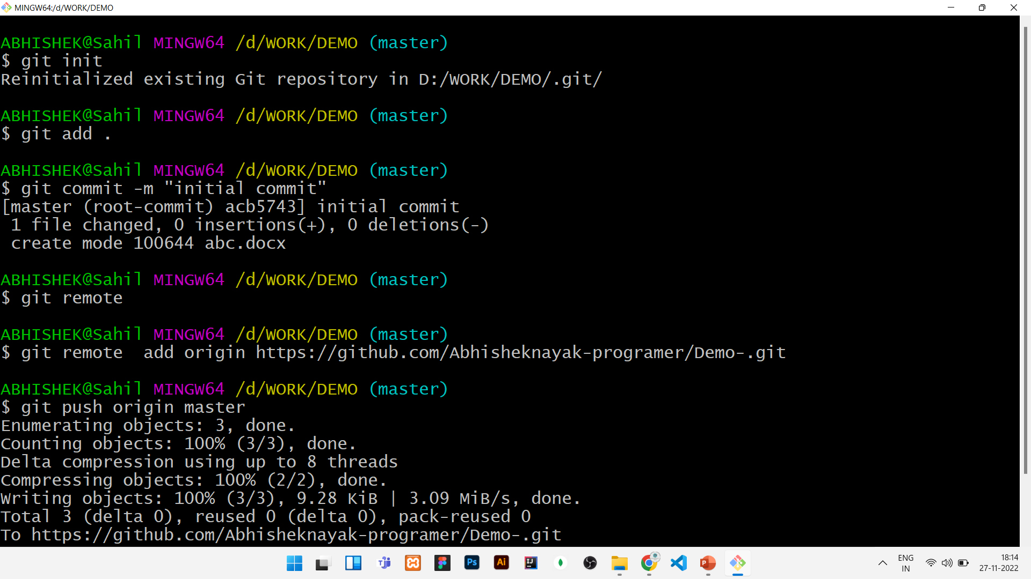

Slide 10
Advantages
GitHub makes it easy to contribute to your open source projects and also available for free if we keep that repository in public.
We can also add collaborators in GitHub so that many people can access that and can also do some changes and can also do code review and we also get a collaborator management page provided by GitHub.
We can replace the owner of the repository whenever needed so that smoothly the complete code can be transferred to the owner or any user.
We can also change the visibility of the repository to the outer world.

Slide 11
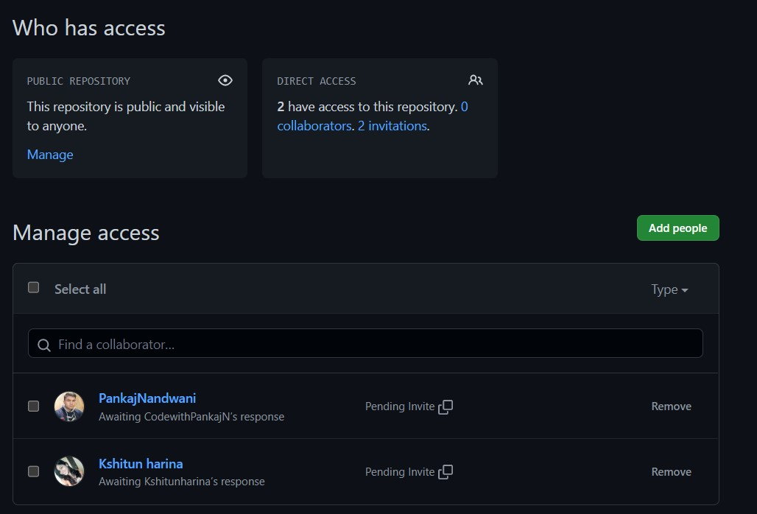

Slide 12
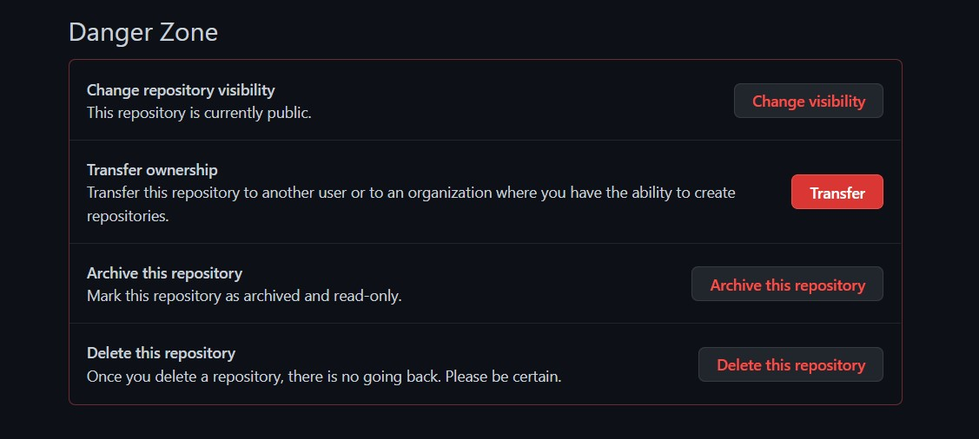

Slide 13
Disadvantages
GitHub is a very powerful tool so it is hard to remember all the things as a beginner. New users can find many different options and ways of doing things in GitHub which is confusing. In particular, many people struggle with Git because of many unintuitive commands and the inconsistency between commands and arguments in the software.
Whenever we keep the repository private at that time many features are there in GitHub which we cannot use.

Slide 14
Future Scope
Now a days most of the software companies and individuals are using this software for developing there application because they can easily track their software and can also see previous code if needed.
GitHub Copilot is a cloud-based artificial intelligence tool developed by GitHub and OpenAI to assist users of Visual Studio Code, Visual Studio, JetBrains integrated development environments by autocompleting code.

Slide 15
Conclusion
So here I conclude that in future a lot of upcoming companies and startups will be using Git and GitHub for their development work of application.

Slide 16
References
https://git-scm.com/ [ Git Link ]
https://github.com/ [ GitHub Link ]

Slide 17
Thank You!

